Slide 1
GMBH Inventory Change Summary
G509 | Aged WIP & Finished Goods | March vs June

Slide 2
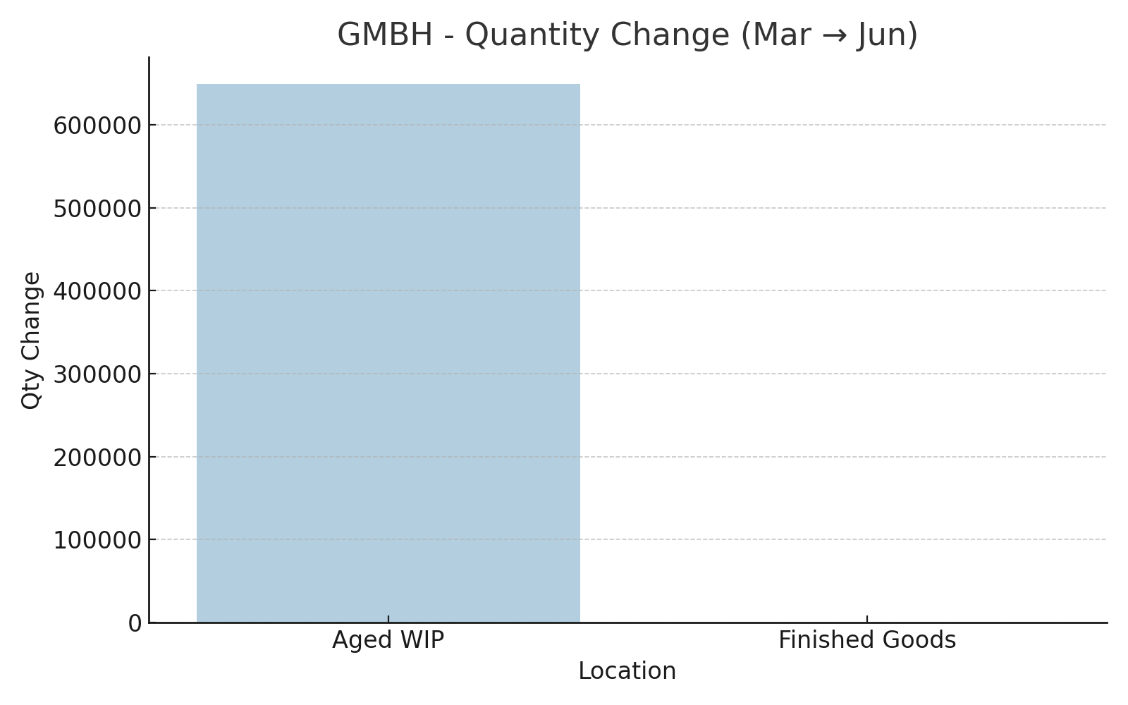
GMBH - Quantity Change by Location (Mar → Jun)

Slide 3
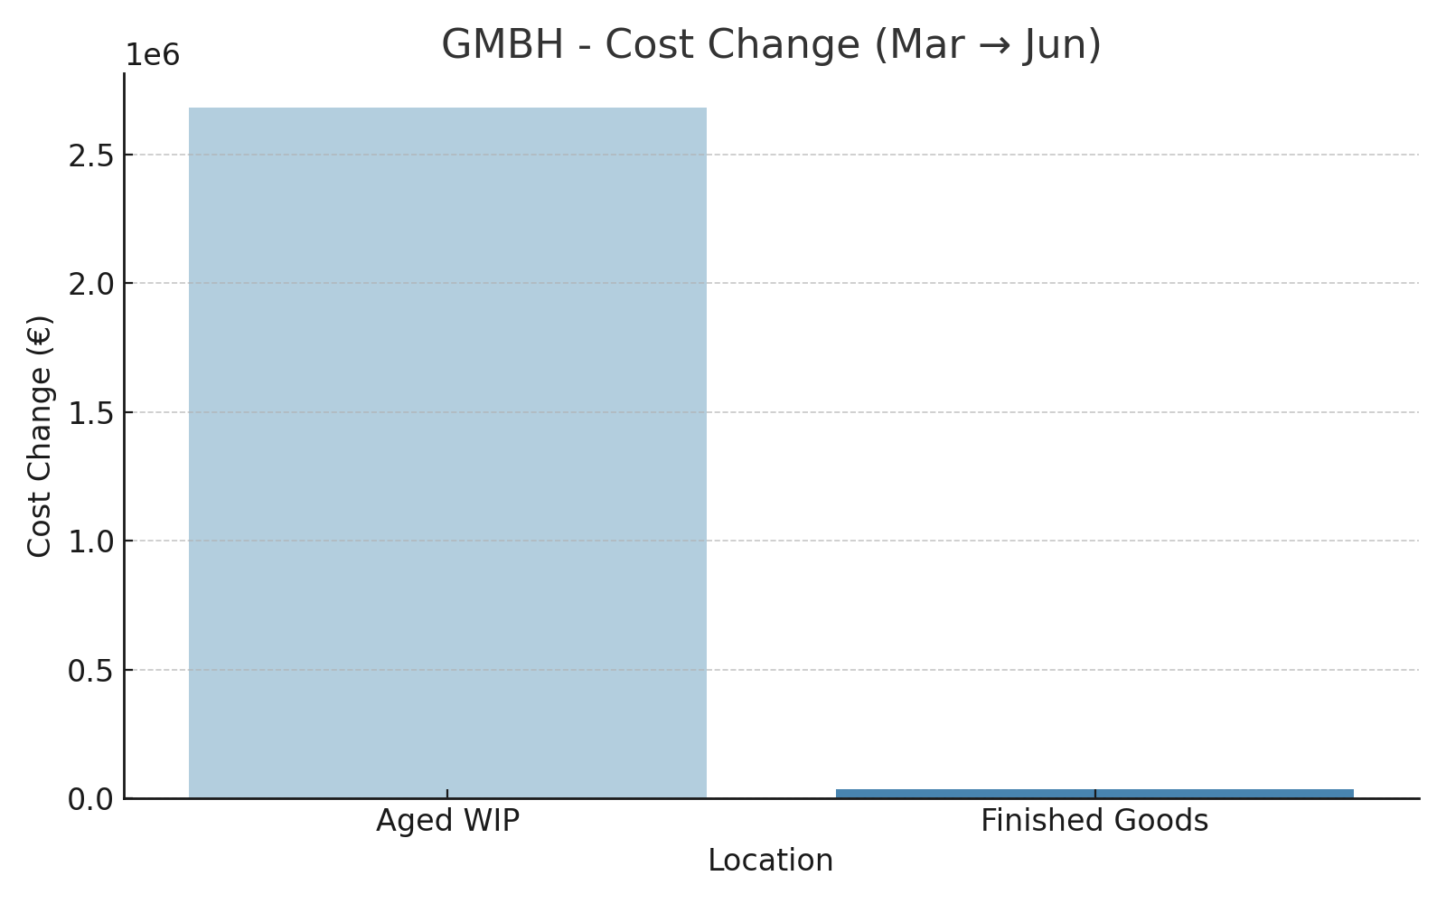
GMBH - Cost Change by Location (Mar → Jun)

Slide 4
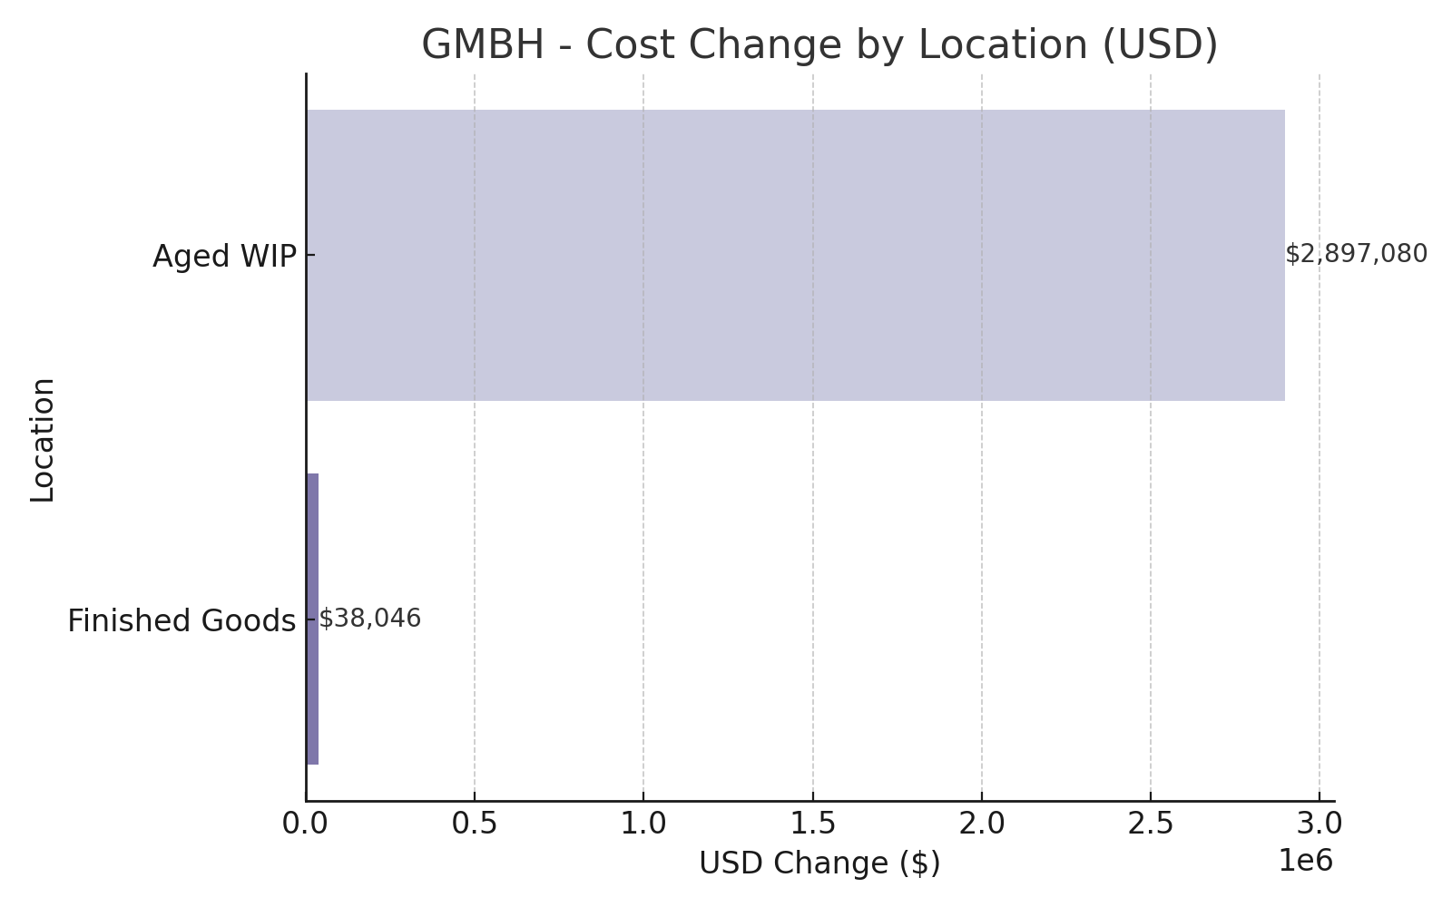
GMBH - Cost Change by Location (USD)

Slide 5
Updated Summary with USD
• Aged WIP cost increased by €2.68M (~$2.90M USD).
• Finished Goods rose by €35.2K (~$38.0K USD).
• These movements indicate significant backlog growth.
• Detailed regional breakdowns follow.

